Slide 1
INTEL UNNATI INDUSTRIAL TRAINING PROGRAM

Slide 2
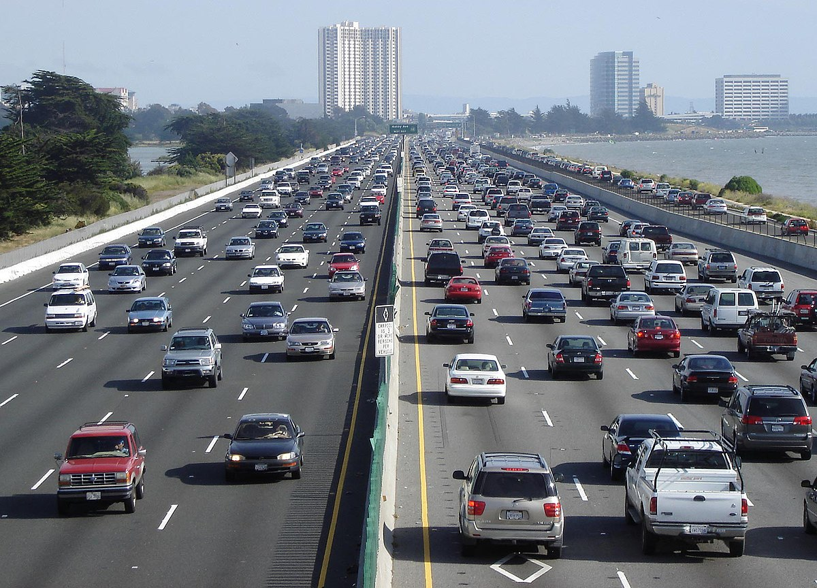
Agenda
MEET OUR TEAM
PROBLEM STATEMENT
IDEA BRIEF
FEATURES OFFERED
TECHNOLOGIES UTILIZED
PROCESS FLOW
PROGRAM CODE
PROOF OF WORKING
CONCLUSION
This Photo by Unknown Author is licensed under CC BY-SA

Slide 3
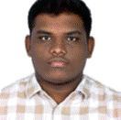
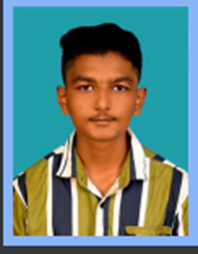
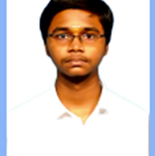
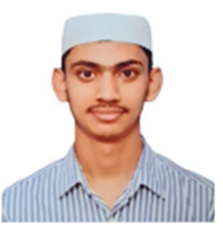
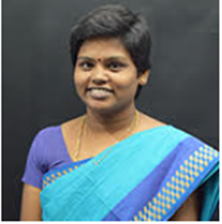
Meet our team
Mohammed Sheik Syed
Yasar Ahamed
Sakthi Kumar
Syed Mohammed Ibrahim
Dr.K.Indra Gandhi, AP(Sel.Gr.) /ECE MENTOR
RRN: 230051601071 SEM: 3RD
BRANCH: ECE
RRN: 230051601128 SEM: 3RD
BRANCH: ECE
RRN: 230051601095 SEM: 3RD
BRANCH: ECE
RRN: 230201601056 SEM: 3RD
BRANCH: E&CE

Slide 4
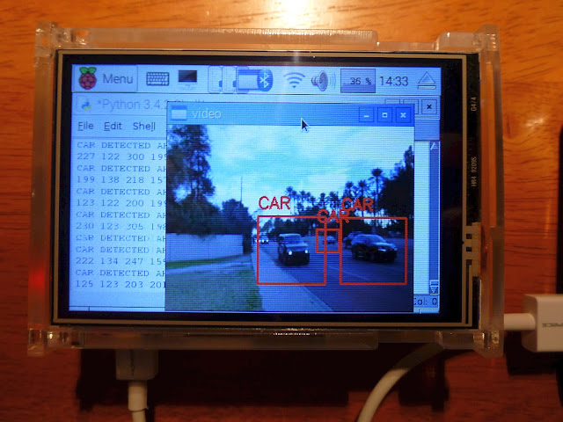
PROBLEM STATEMENT
VECHILE CUT IT DETECTION CATEGORY: ARTFICIAL INTELLIGENCE MACHINE LEARNING DEEP LEARNING AUTONOMOUS DRIVING
This Photo by Unknown Author is licensed under CC BY
This Photo by Unknown Author is licensed under CC BY-SA-NC

Slide 5
IDEA BRIEF
In today's automotive industry, ensuring safety through advanced driver assistance systems (ADAS) and autonomous vehicles requires robust capabilities in real-time object detection and collision prediction. This project focuses on developing a system that leverages deep learning and computer vision techniques to detect vehicles in video streams and estimate their Time-to-Collision (TTC).

Slide 6
KEY FEATURES:
Real-time vehicle detection using YOLOv8s model.
Precise Time-to-Collision (TTC) estimation for potential collision prediction.
Adaptive edge detection and preprocessing using OpenCV.
Alert mechanism triggered by critical TTC thresholds.
Video output with annotated frames for visual inspection and analysis.

Slide 7
TECHNOLOGIES UTILIZED:
Deep Learning: YOLOv8s model for efficient and accurate vehicle detection.
Computer Vision: OpenCV for preprocessing, edge detection, and frame visualization.
Python Programming: Language used for system implementation and integration of libraries.
Video Processing: Utilizes codecs and video writer functionality from OpenCV.
Performance Evaluation: Tested across diverse video datasets for robustness and accuracy.
Trigger alerts based on predefined TTC thresholds.

Slide 8
Process flow
Initialization
Frame Processing Loop
Output
Initialize YOLOv8s model for vehicle detection
Open video file and set frame dimensions.
Preprocess each frame (resize, blur, grayscale)
Enhance edges using Canny edge detection and morphological operations
Detect vehicles using YOLOv8s, filter based on confidence scores
Calculate TTC between consecutive frames
Trigger alerts based on predefined TTC thresholds
.
Visualize processed frames with annotations (vehicle labels, TTC values)
Write annotated frames to an output video file.

Slide 9
Program or code:
import cv2
import numpy as np
from ultralytics import YOLO
# Initialize YOLOv8s model
model = YOLO('yolov8s.pt')
# Path to the input video file
video_path = r'C:\Users\User\OneDrive\Desktop\Intel\Vehicle_Detection_Image_Dataset\sample_video.mp4'
# Open the video capture
cap = cv2.VideoCapture(video_path)
# Get the frame dimensions for window resizing
frame_width = int(cap.get(cv2.CAP_PROP_FRAME_WIDTH))
frame_height = int(cap.get(cv2.CAP_PROP_FRAME_HEIGHT))

Slide 10
# Define the desired output frame size
output_width = 640
output_height = 480
# Create a resizable window
cv2.namedWindow('Frame', cv2.WINDOW_NORMAL)
cv2.resizeWindow('Frame', output_width, output_height)
# Parameters for edge detection
edge_threshold1 = 50 # Lower threshold
edge_threshold2 = 150 # Upper threshold
kernel = np.ones((3, 3), np.uint8) # Kernel for morphological operations
# Parameters for cut-in detection
alert_threshold = 0.7 # Confidence threshold for detection
fps = cap.get(cv2.CAP_PROP_FPS)
alert_frame_threshold = int(alert_threshold * fps)

Slide 11
# Initialize variables for cut-in detection
cut_in_detected = False
cut_in_start_frame = None
# Define the codec and create VideoWriter object
fourcc = cv2.VideoWriter_fourcc(*'XVID')
out = cv2.VideoWriter('output_video.avi', fourcc, fps, (output_width, output_height))
# Variables for TTC calculation
prev_boxes = []
prev_frame_time = None
# TTC alert threshold
ttc_alert_lower = 0.5
ttc_alert_upper = 0.7
while cap.isOpened():
ret, frame = cap.read()
if not ret:
break

Slide 12
# Resize the frame to the desired output size
frame = cv2.resize(frame, (output_width, output_height))
# Preprocessing: Gaussian blur to reduce noise
blurred = cv2.GaussianBlur(frame, (5, 5), 0)
# Convert to grayscale
gray = cv2.cvtColor(blurred, cv2.COLOR_BGR2GRAY)
# Adaptive thresholding for better edge detection
mean_intensity = np.mean(gray)
edge_threshold1 = max(0, 0.66 * mean_intensity)
edge_threshold2 = min(255, 1.33 * mean_intensity)
# Perform edge detection using Canny edge detector
edges = cv2.Canny(gray, edge_threshold1, edge_threshold2)
# Morphological operations to enhance edges

Slide 13
edges = cv2.dilate(edges, kernel, iterations=1)
edges = cv2.erode(edges, kernel, iterations=1)
# Perform object detection using YOLOv8s
results = model(frame)[0]
car_detected = False
current_boxes = []
# Iterate over detected objects
for result in results.boxes:
box = result.xyxy[0]
cls = int(result.cls[0])
conf = result.conf[0]
label = model.names[cls]
# Check if the detected object is a car and meets the alert threshold
if label == 'car' and conf >= alert_threshold:
car_detected = True

Slide 14
# Draw the bounding box
x1, y1, x2, y2 = int(box[0]), int(box[1]), int(box[2]), int(box[3])
current_boxes.append((x1, y1, x2, y2))
cv2.rectangle(frame, (x1, y1), (x2, y2), (0, 155, 0), 2) # Green bounding box
# Calculate TTC
if prev_boxes and prev_frame_time:
current_frame_time = cap.get(cv2.CAP_PROP_POS_MSEC) / 1000.0 # Current time in seconds
time_diff = current_frame_time - prev_frame_time
for i, (x1, y1, x2, y2) in enumerate(current_boxes):
if i < len(prev_boxes):
prev_x1, prev_y1, prev_x2, prev_y2 = prev_boxes[i]
# Calculate distances
distance_current = np.sqrt((x2 - x1) ** 2 + (y2 - y1) ** 2)
distance_prev = np.sqrt((prev_x2 - prev_x1) ** 2 + (prev_y2 - prev_y1) ** 2)
# Calculate relative speed (pixels per second)

Slide 15
speed = (distance_prev - distance_current) / time_diff if time_diff > 0 else 0
# Estimate TTC (assuming constant speed)
ttc = distance_current / speed if speed != 0 else float('inf')
# Display vehicle name in yellow and TTC in blue
cv2.putText(frame, label, (x1, y1 - 10), cv2.FONT_HERSHEY_SIMPLEX, 0.5, (0, 255, 255), 1) # Yellow vehicle name
cv2.putText(frame, f'TTC: {ttc:.2f}s', (x1, y1 - 30), cv2.FONT_HERSHEY_SIMPLEX, 0.5, (0,255,0), 1) # Blue TTC
# Check if TTC is below the alert threshold
if ttc_alert_lower < ttc < ttc_alert_upper:
cv2.putText(frame, 'ALERT: TTC below threshold!', (50, 50), cv2.FONT_HERSHEY_SIMPLEX, 1, (0, 0, 255), 2)
print("ALERT: TTC below threshold!")

Slide 16
# Update previous frame data
prev_boxes = current_boxes
prev_frame_time = cap.get(cv2.CAP_PROP_POS_MSEC) / 1000.0
# Check for cut-in detection based on object detection
if car_detected:
if not cut_in_detected:
cut_in_detected = True
cut_in_start_frame = cap.get(cv2.CAP_PROP_POS_FRAMES)
else:
cut_in_detected = False
# Check if the cut-in has persisted beyond the alert threshold
if cut_in_detected:
current_frame = cap.get(cv2.CAP_PROP_POS_FRAMES)
if current_frame - cut_in_start_frame >= alert_frame_threshold:
print("ALERT: Vehicle cut-in detected for 0.7 seconds!")
cut_in_detected = False

Slide 17
# Write the frame to the output video file
out.write(frame)
# Display the frames
cv2.imshow('Frame', frame)
cv2.imshow('Edges', edges) # Display edges for debugging purposes
# Check for user input to quit
if cv2.waitKey(1) & 0xFF == ord('q'):
break
# Release the video capture, video writer, and close all windows
cap.release()
out.release()
cv2.destroyAllWindows()

Slide 18
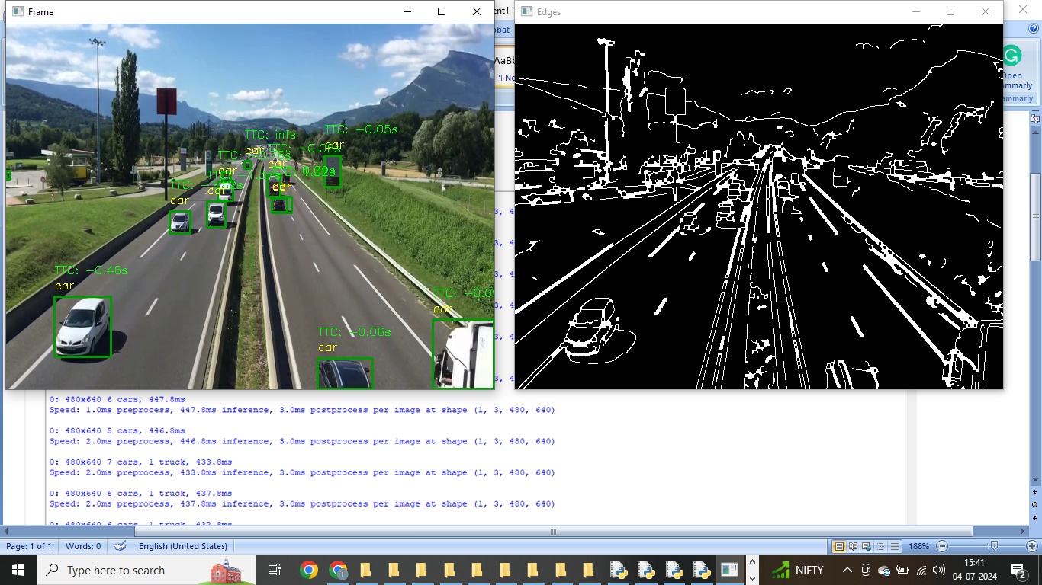
PROOF OF WORKING
WORKING VIDEO LINK

Slide 19
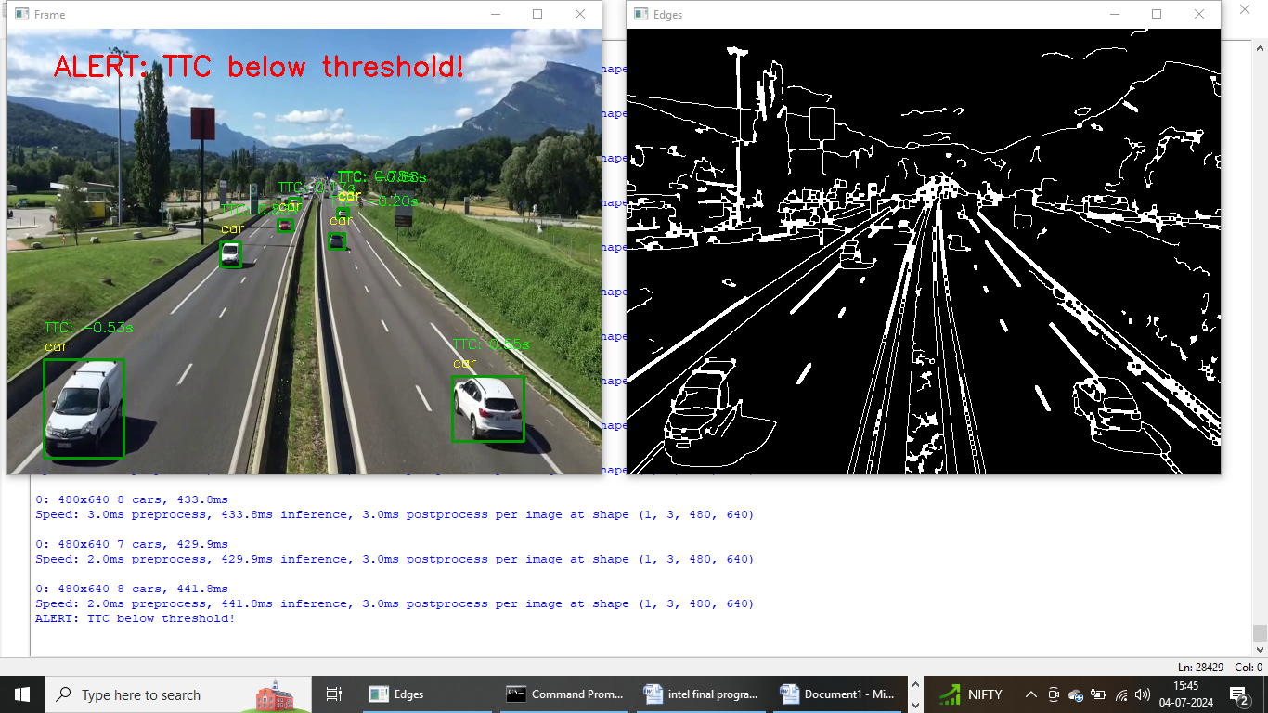
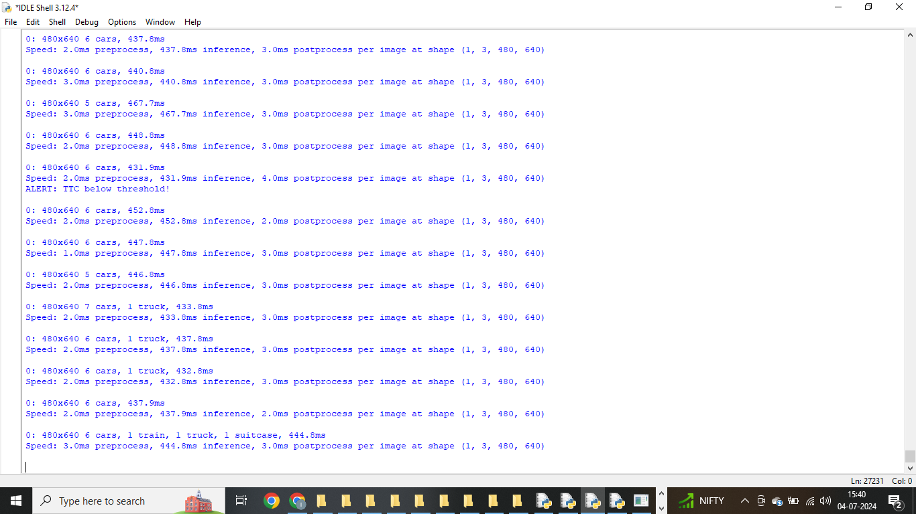

Slide 20
CONCLUSION
This project successfully developed a real-time vehicle detection and TTC estimation system using deep learning and computer vision techniques. By leveraging YOLOv8s for efficient object detection and OpenCV for preprocessing and visualization, the system provides a comprehensive solution for predicting collision risks in dynamic traffic environments. Future enhancements could focus on optimizing performance for real-world deployment, integrating with vehicle control systems, and enhancing robustness against complex scenarios.

